Slide 1

New Ho-Chunk Nation Garden
Notes:
Chuck - Intro

Slide 2
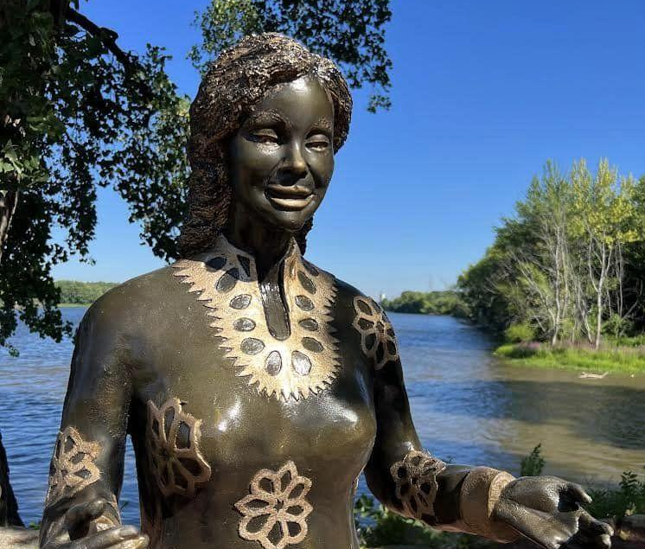
Our Vision
Riverside International Friendship Gardens (RIFG) will be a place of beauty, reflecting our appreciation for the diverse cultures that share the earth.
Notes:
Chuck

Slide 3
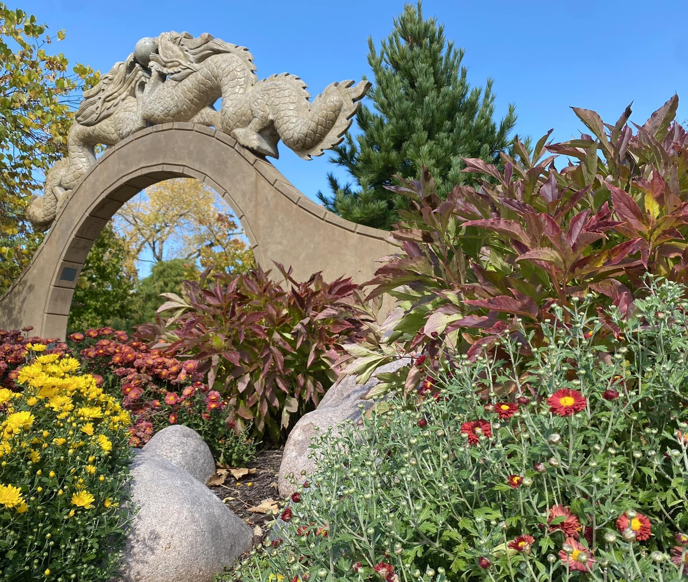
The Gardens
-About 2 acres surrounding the Hatchery LLC venue at the north end of Riverside Park
-Wheelchair accessible
-Part of the City of La Crosse Park System
Notes:
Chuck

Slide 4
New Ho-Chunk Garden
The Riverside International Friendship Gardens Board of Directors have been working with members of the Ho-Chunk Nation to create a Ho-Chunk Garden to be included in the Riverside International Friendship Gardens at Riverside Park.
The garden will be west of the existing Cameroon Garden and will have unrestricted views of the La Crosse, Black, and Mississippi Rivers.
Notes:
Tracy

Slide 5
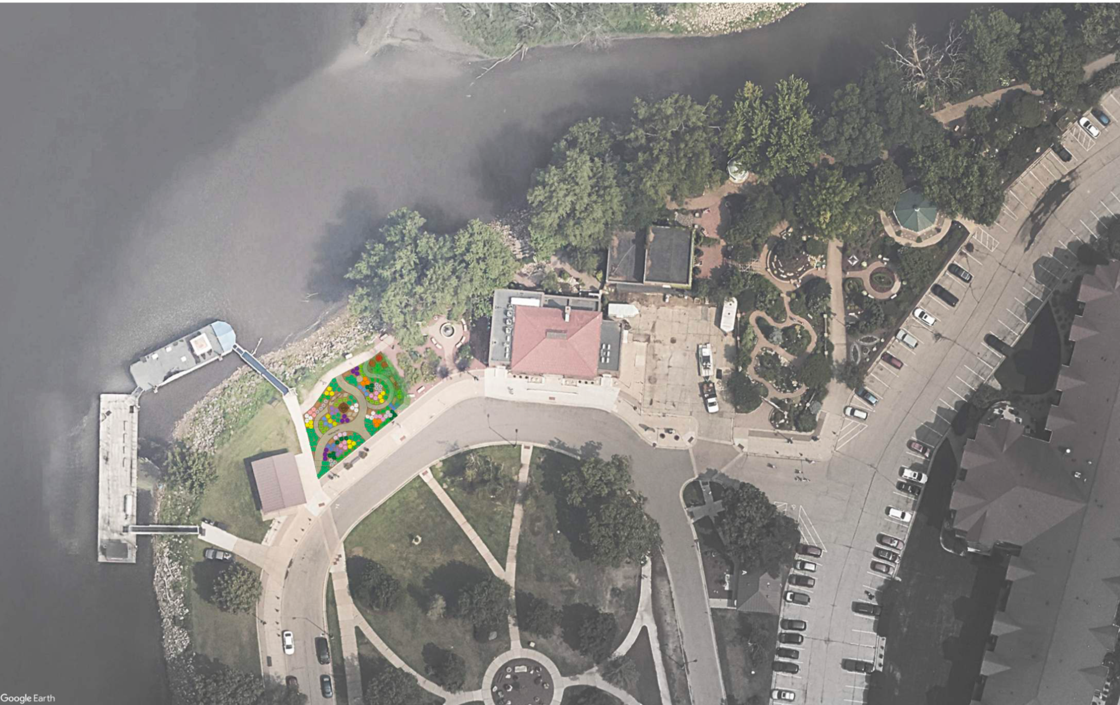
Notes:
Chuck hands it off to Jud

Slide 6
Ho-Chunk Nation Inspiration
Ho-Chunk Nation representatives have recommended a sculpture depicting Betsy Thunder. Betsy Thunder was a native healer who in the 1860’s used her healing skills to help both native peoples and the newly arriving settlers.
The Ho-Chunk representatives have expressed their desire to symbolize through this sculpture a sense of community, friendship, and healing.
They have also indicated they would like the garden to include native plants, including healing plants.
Notes:
Tracy

Slide 7
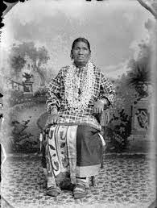
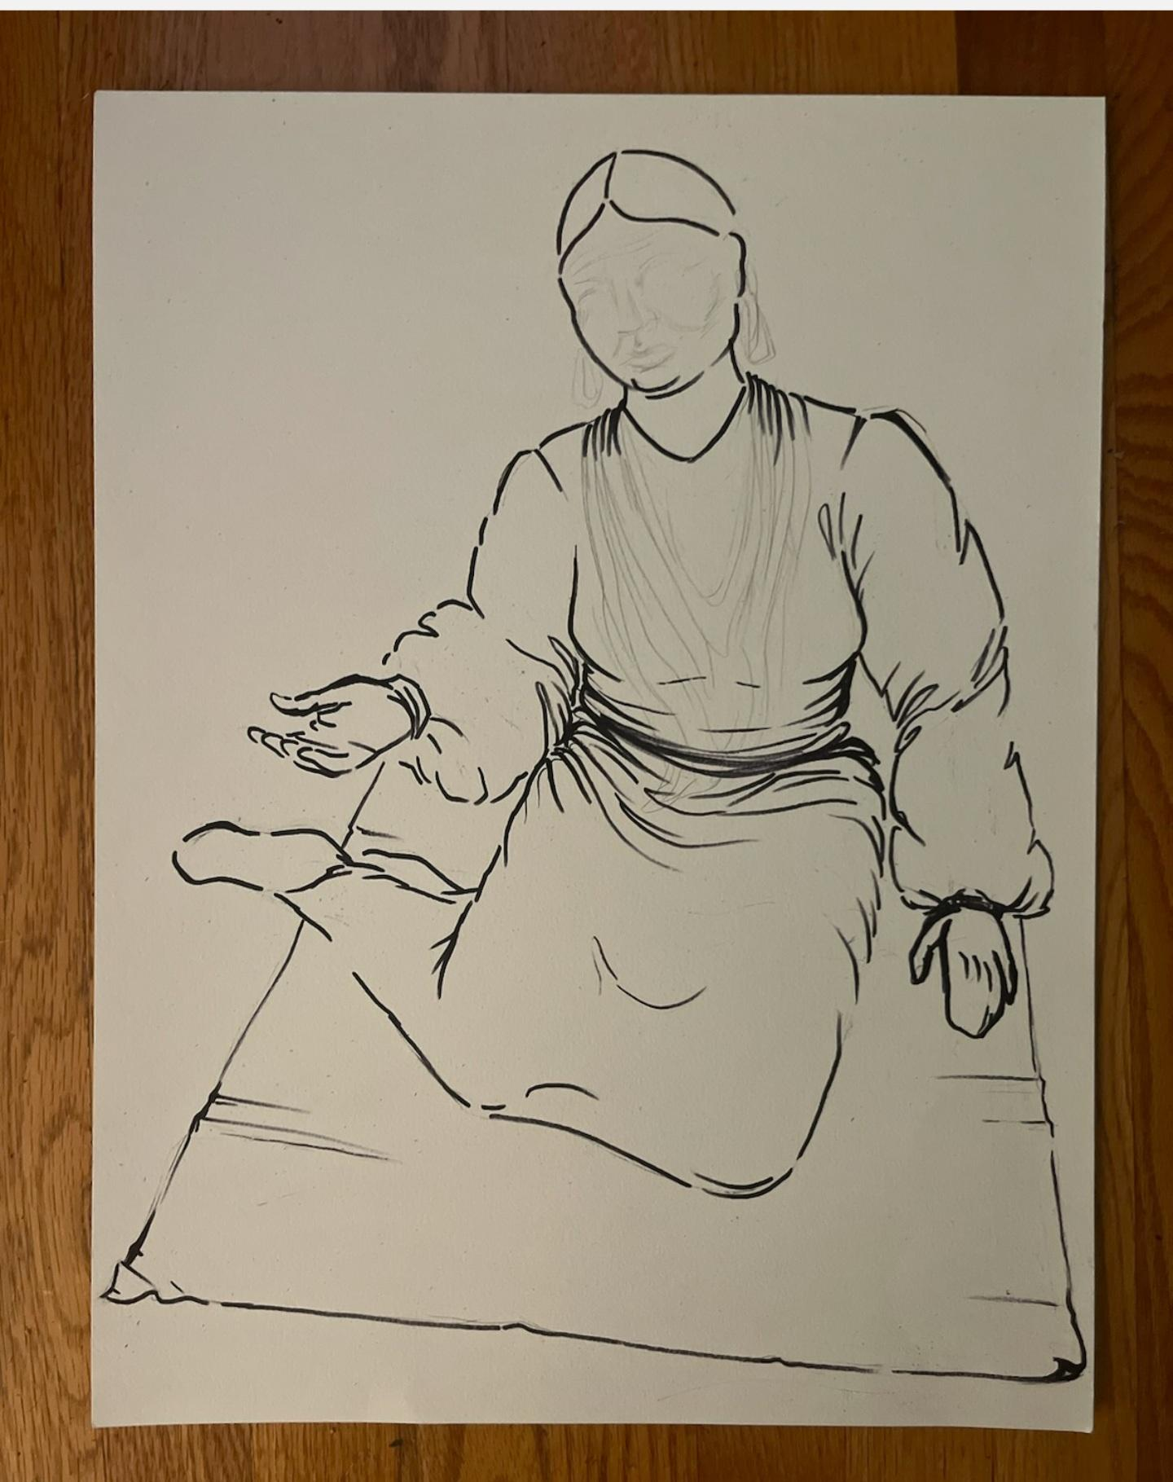
Betsy Thunder: A traditional Ho-Chunk healer born in the 1850’s
Notes:
Tracy

Slide 8
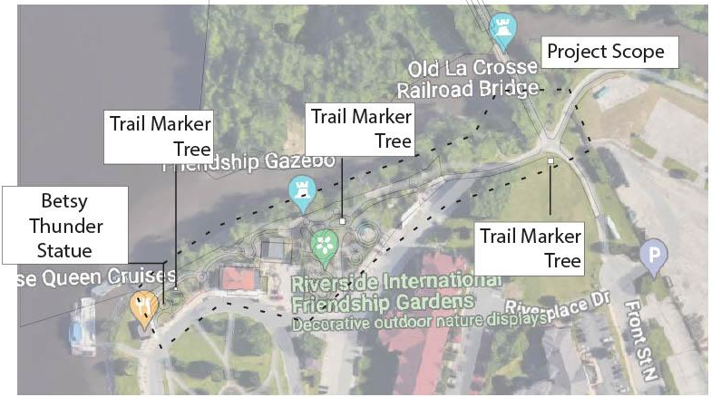
Trail Marker Trees
The Ho-Chunk, as well as other native peoples, would shape young trees in a particular way to indicate a direction or other information and when the trees matured, the “map” could be used for many years.
We are proposing a trail marker in the main Ho-Chunk Garden followed by three other trail marker trees that would be placed throughout the International Gardens marking the “Ho-Chunk Trail,” with the last such marker at the bridge that crosses the La Crosse River.
Notes:
Tracy
The expense for the trail marker trees, which would also be in bronze, has been estimated at approximately $100,000.

Slide 9
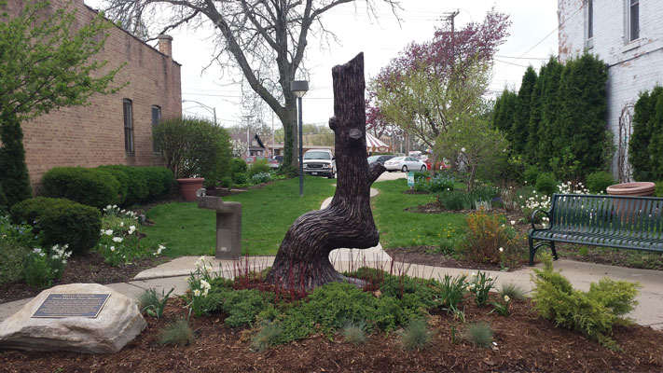
Trail Marker Trees

Slide 10
Garden Design
In addition to the existing quaking aspens, cedar and dogwood trees will be planted to create a beautiful living screen between the gardens.
Native plantings were designed in collaboration with members of the Ho-Chunk Nation to provide medicinal plants, ecological biodiversity, and to provide color and blooms throughout the entire growing season.
There will also be educational signage to help the public learn more about Ho-Chunk culture.
Notes:
Jud

Slide 11
Garden Design
The garden will include flagstone benches made from local stone.
The large pathways will be barrier-free accessible and constructed of the same materials throughout the Garden, reflecting that we are all part of the same good earth and we all have a responsibility to protect and preserve it for future generations. Smaller pathways will be made from ground limestone.
Notes:
Jud.
We estimate approximately $50,000 for the landscaping, sculpture bases, structural engineering, civil hydraulic study, and paving materials for the walkways.

Slide 12
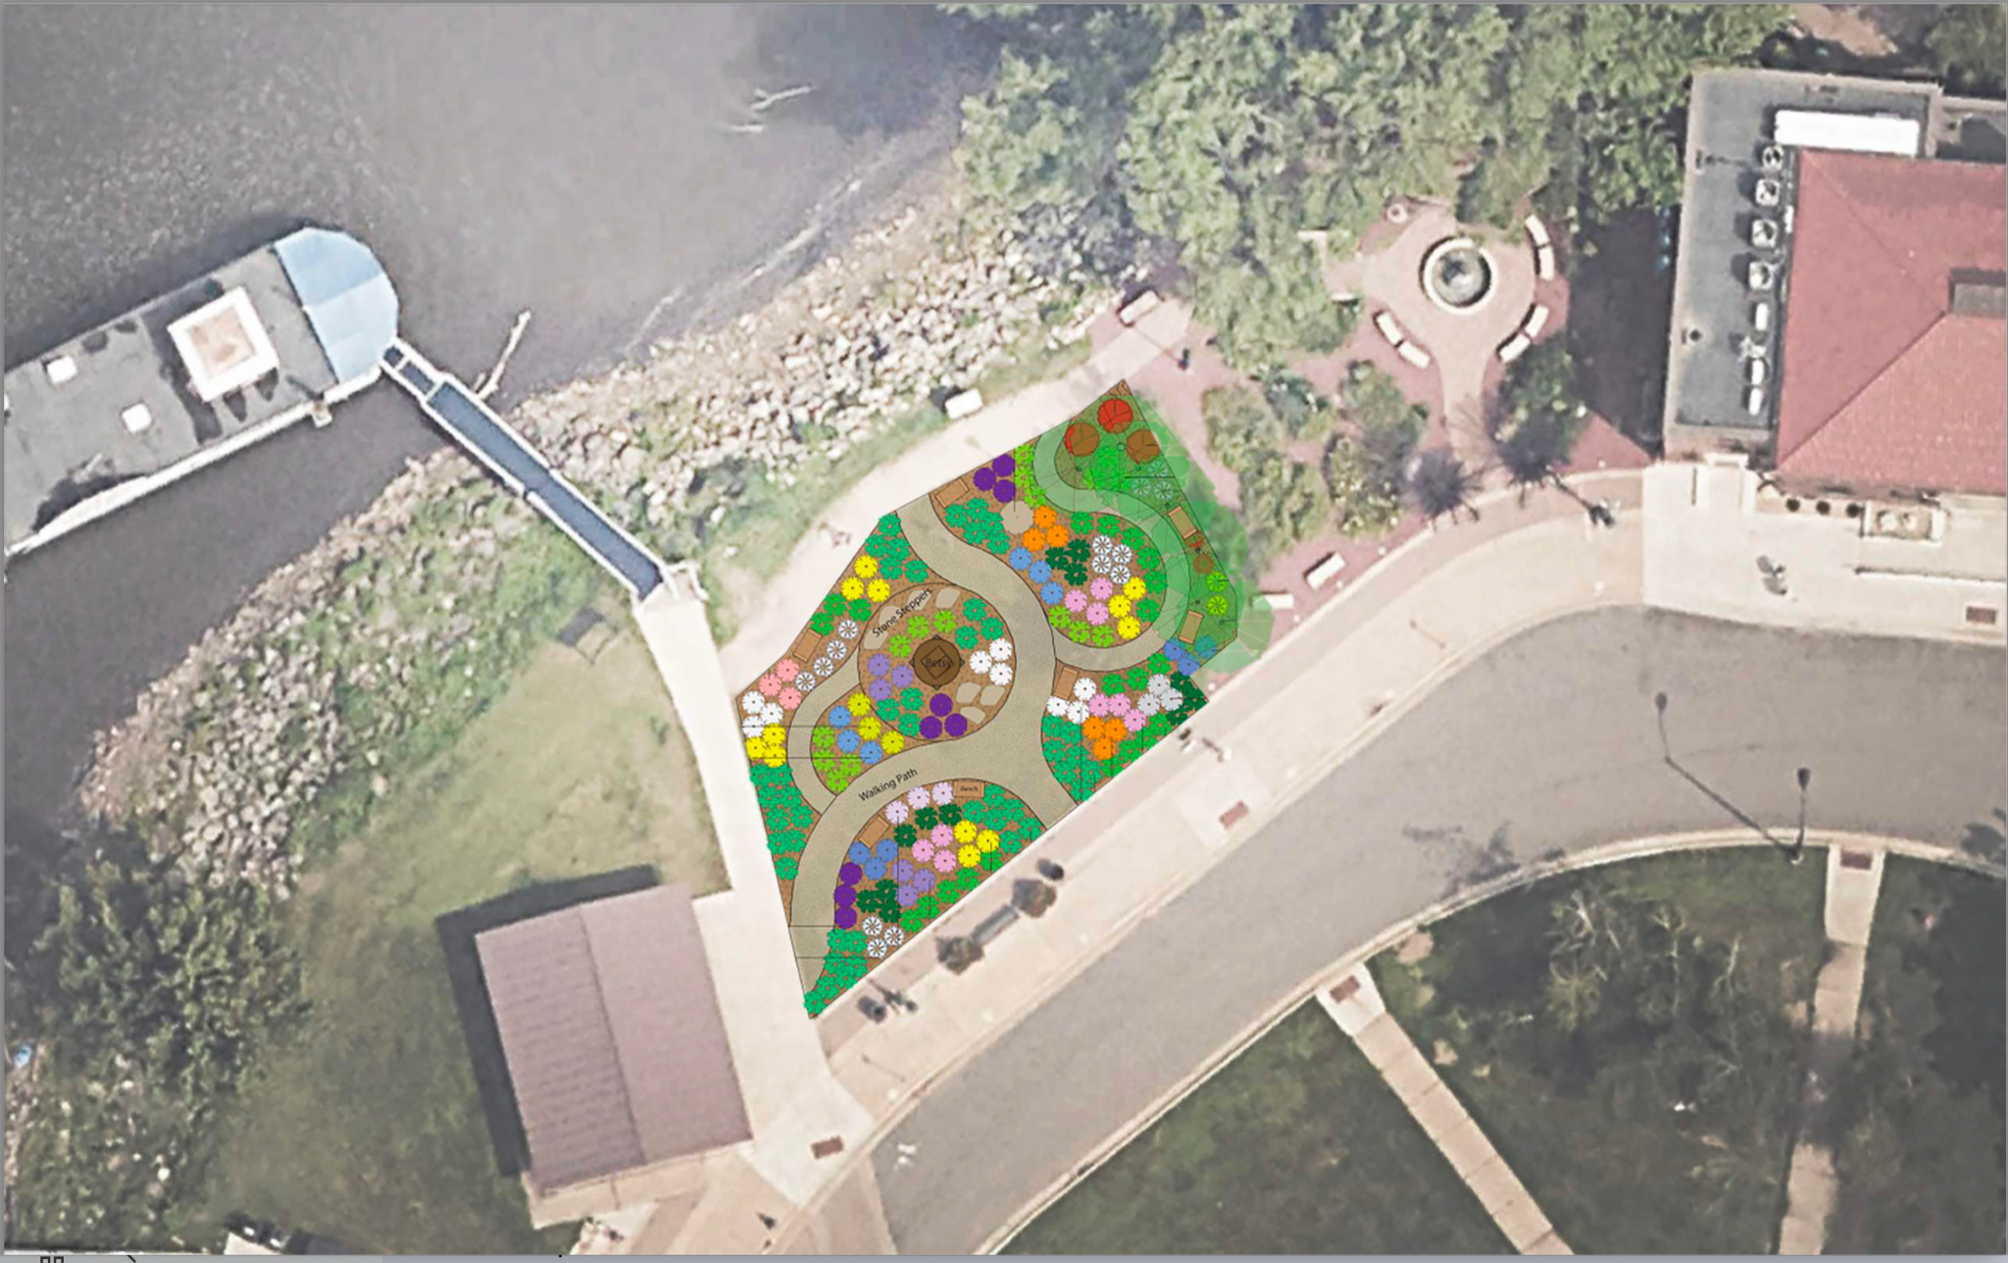
Notes:
Jud

Slide 13
Pathway Material
Notes:
Jud.
We estimate approximately $50,000 for the landscaping, sculpture bases, structural engineering, civil hydraulic study, and paving materials for the walkways.

Slide 14
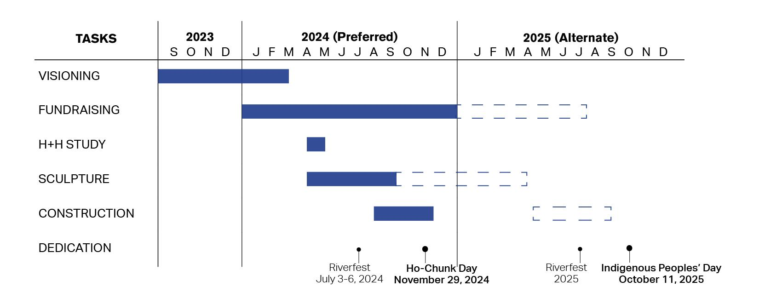
Ho-Chunk Garden Timeline
Notes:
Val

Slide 15
Project Estimate
Bronze Sculpture of Betsy Thunder: $165,000
Bronze Trail Marker Trees: $100,000
Civil and H and H Study: Makepeace Engineering: $7,000
Structural Engineering: Pierce Engineering: $1,000
Landscape install; general construction work including foundation for structures; Accent lighting; Benches and Stones for donors: $77,000
In Kind Services: Landscape Design and Concept Planning by Coulee Region Ecoscapes; Consulting and Construction Documents by River Architects
Total: $350,000
Notes:
Val

Slide 16
How to Support the Project
Rotarians:
Donate securely online at rotary6250.org.
Or mail a check:
Check made payable to “Rotary District 6250 Foundation, Inc.” and note Ho-Chunk Nation Garden in the check’s memo field and send to:
Rotary District 6250 Foundation
c/o Treasurer Brian Watson
4030 E Stone Ridge Dr
Milton, WI 53563
Others:
Donate securely online at riversidegardens.org.
Or mail a check:
Note Ho-Chunk Nation Garden in the check’s memo field.
Riverside International Friendship Gardens, Inc.
PO Box 3473
La Crosse, WI 54602-3473
Stay tuned for volunteer opportunities! To join the ad-hoc committee, contact Chuck Hanson or Sarah Arendt-Beyer.
Notes:
Val

Slide 17

We are all part of the same good earth.
We believe there is beauty in diversity.
In each garden one visits, one should find a reflection of a different culture, and experience beauty. Every culture has something to offer.
Please join us in making this beautiful friendship garden a reality.
Questions? Contact Chuck Hanson: CEH@haleskemp.com.
Notes:
Chuck

